Slide 1


Implementing Standards
Keys to Success
Bob Cornacchioli
get2bobc@gmail.com
http://www.derotechnical.com

Slide 2

Understanding Common Language
Constraints and “Givens” in PowerSchool
Best Practices- Standards are Coming!
Importing Standards using Excel
Grade Scales
Looking at PTP
Report Card options
Changes due to PS 12.X
Agenda/Participants will be engaged in:
All PPT can be found @
www.derotechnical.com

Slide 3




CEO - DERO Technical Services (2007)
Marketing/- ParkBench Software Trainer (2007)
Evangelist/Process Lead- Level Data (2010)
PSISJS Partner – Standards/Trainer (2013)
Alpha/Beta Team for PS and PTP
Bob Cornacchioli
Director of Technology and Media Services
Shrewsbury Public Schools (16 yrs.)
PowerSchool Administrator (6 yrs.)

Slide 4

Who are you?
Traditional or Standards Grades?
  Teachers have graded
  Teachers will be grading
  Selection Process?
  Special Needs/GIFTED/ELL Students
  Modified Curriculum
  Gradebook PowerTeacherPro
  Start Date- This year?
  Hybrid Anyone ( Traditional and Standards)
Going/Gone to PS19

Slide 5

When do retire standards?
How do you retire standards? (ZOLD-course association)
Why did you retire standards?
What happens if you decided to retire standards after EOY?
Lots of Standards Resources can be found @
www.derotechnical.com

Slide 6
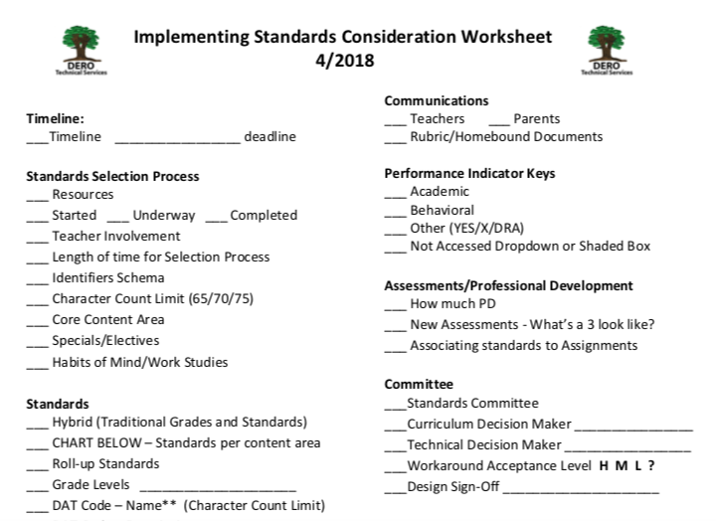
Standards Worksheet http://www.derotechnical.com/STANDARDS
Not as critical in the past with PB Visual PST 3.1

Slide 7
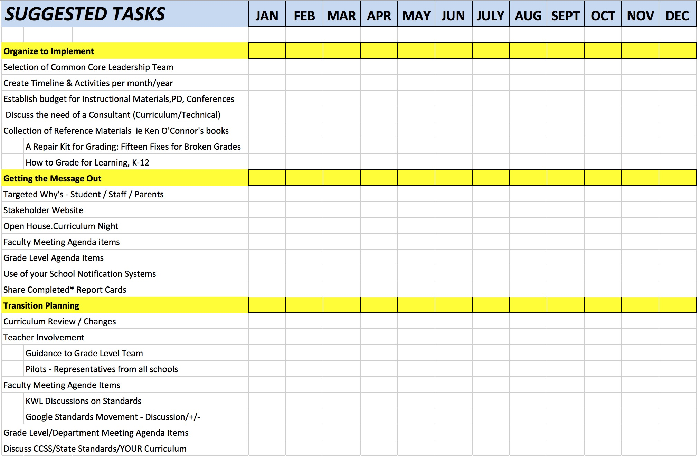
Suggested Tasks and Benchmarks
SAMPLE
May 3,2013 – Standards Finalized-uploaded to Google Docs
May 8,2013 – Onsite development of preK-5 SBRC
May 30, 2013 Onsite training of Vanguard Teachers
Sept 14, 2013 – Modifications to SBRC and WIDA
http://www.derotechnical.com/STANDARDS/Standards.html

Slide 8

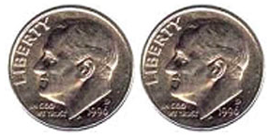
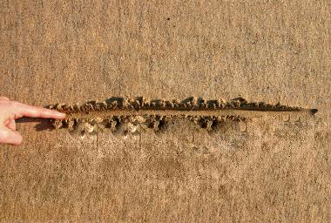
CURRICULUM/ADMIN & TECHNICAL
SHIFT
Go slow to get it right!
DRAW A LINE IN THE SAND
Collaborate and learn the constraints

Slide 9

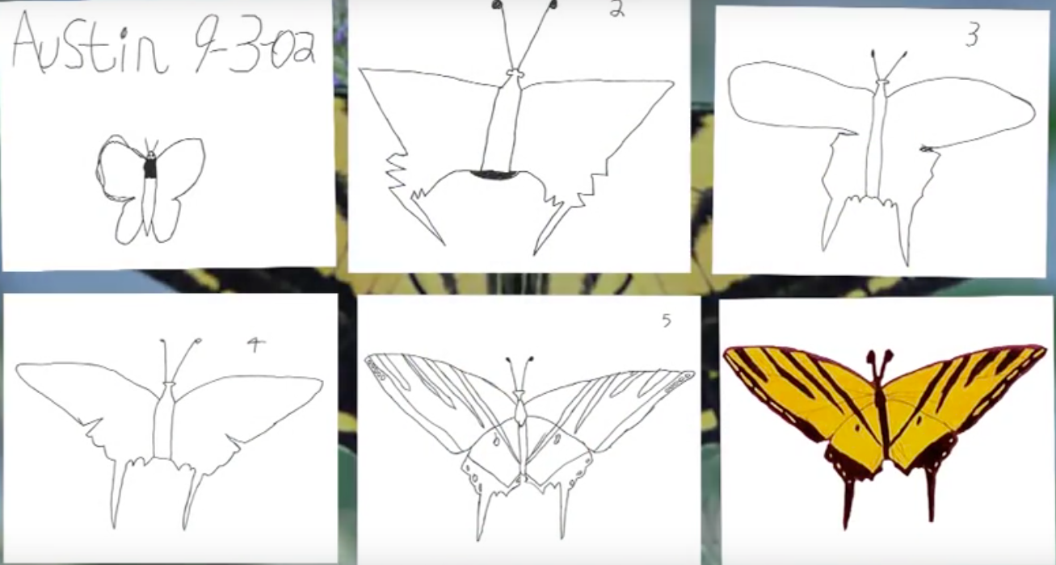
AUSTIN’S BUTTERFLY
Featuring Ron Berger from Expeditionary Learning.
Produced by David Grant (www.elschools.org)
Next Faculty
Meeting
https://www.youtube.com/watch?v=hqh1MRWZjms

Slide 10

Standard Based vs. Standards Aligned
Curriculum should be developed entirely based on CCSS/C3/NGSS.
Stakeholders must take a look at the standards, separate each skill per standards (there are often several per standard) and write the skills in language that free of educational jargon.
Additionally, ‘I can' statements should be linked to every single assessment question- no exceptions.
If the above has not taken place, but standards are identified in assessment & teacher practice generally, it means that the curriculum is only standards aligned. That's great, but it doesn't fully cut it.
Most Social Studies and Science curriculum is only standards aligned as publishing companies have not even caught up yet in 2019.
Bill Stanton
Director of Curriculum and Assessment

Slide 11

Before the “selection process”
Review/Change curriculum alignment across all subjects and grade levels – which subjects haven’t been reviewed, recent purchases, expected new purchases.
Gather your resources –International Baccalaureate, Common Core, State Standards, Existing Standards, District Alike Standards**.
Create new forms of assessments - the better assessments align with your curriculum and allow many of your standards to associated to them and/or assignments.
How much time does this take?? – My recommendation is 24 to 6 months!
Skipping these steps will result in at best - continuous revisions and most often FAILURE!

Slide 12
Selecting Your Standards
Grade level teacher Team* - Pilot concerns
Discussions vs. Disagreements – STRONG ADMIN LEADERSHIP
Set guidelines - # of standards per content area per grade level including Life Skills/Work Habits/Successful Skills for Learning
Different Student Groups _ GIFTED, Special Education, ELL
Benchmark Dates – 1st Draft per content area
Compare Standards # by Content by Grade Level
SET/KEEP* FINAL Date– No more changes after…
IF YOU BUILD IT, THEY WILL COME– Changes before EOY
Final Standards must be PARENT FRIENDLY- AVOID educational jargon!
 | PreK | K | 1 | 2 | 3 | 4 | 5
ELA | 15 | 12 | 18 | 10 | 17 | 23 | 32
MA | 12 | 6 | 12 | 13 | 13 | 14 | 14
SCI | 2 | 2 | 3 | 14 | 3 | 3 | 4

Slide 13










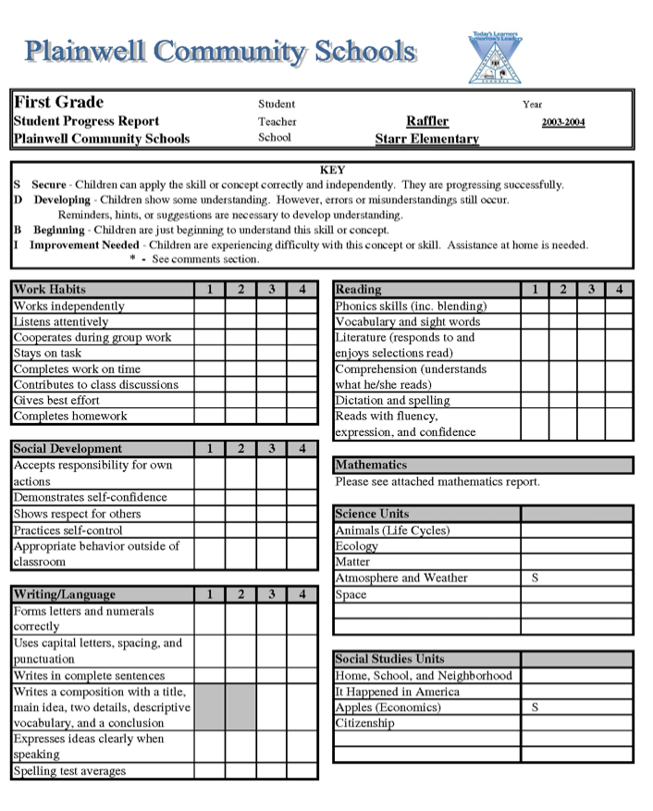


Standard Resources
ELA 2
71
MA 2
28
CAREFUL

Slide 14
? Related Subjects/Specials ?
What I have seen and continue to see…
More focus on ELA – MA – BEHAVIORAL – SCI – SOC
Participation grades
General standards – not grade specific
Specialist Rosters – Entire Elementary Schools # of students
Specialist – Masters of the Fill Down
Very few clients ask for Specialist Comments
New Treads:
  3-5 total standards for all specials
  Academic Performance per content area not grade level
  Behavior Standards ( eliminates the need for a comment)
  BS standards - same of all related subjects, selected from those for core academic subjects

Slide 15
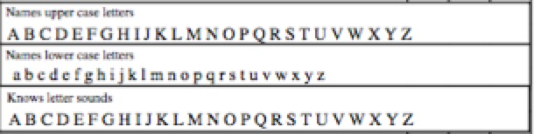
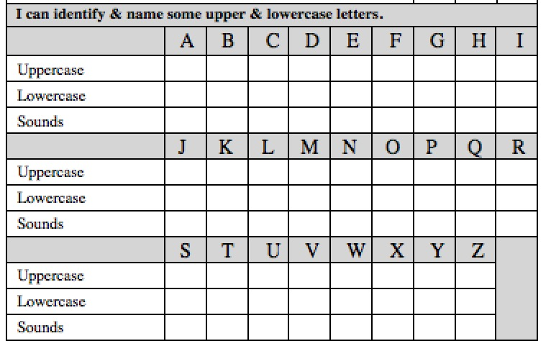
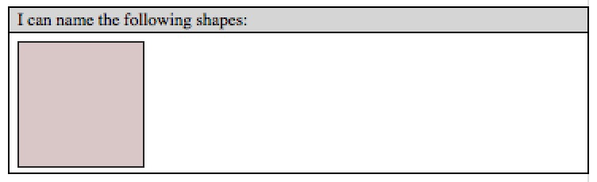

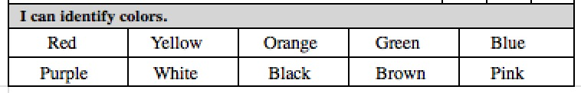
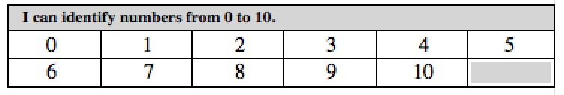
Constraints/Decisions
Letter Recognition and Sounds
Post Printing Circles – No Historical Record T2T
Post Printed √ – No Historical Record T2T
IF STANDARDS – 78 standards – Ask Teachers?
Shape/Color and Number Recognition
This picture is stored li1e school
logo’s. JPG
If you choose summative standards for concepts, you may need to provide parents with term
benchmark expectations!

Slide 16
Change requires continual checking of your stakeholders temperature.
HAS THIS HAPPENED YET?
Parents
Teachers
Tech Team

Slide 17



Read anything by Ken O’Connor aka The Grade Doctor
C
Far more important than the grade is how the district has trained teachers in the proper techniques in determining that grade. PowerTeacherPro has been designed with many of Ken O’Connor’s principles.
Evidence
MISSING WORK
TENDENCY
Learning Conversations:
The Culture of Grading
Have you had these chats yet?
MAKE UP WORK
EXTRA CREDIT
HOPE
ZERO’s

Slide 18

High Recommended - Standard Based Learning FB Page
Ken O’Connor is a frequent contributor to this page
Searchable by content areas as well… nice feature
https://www.facebook.com/groups/standardsbasedlearningandgrading/

Slide 19
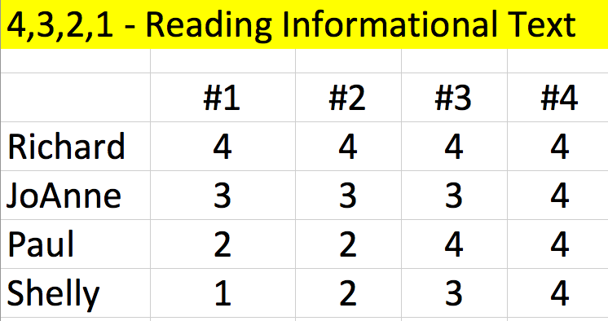
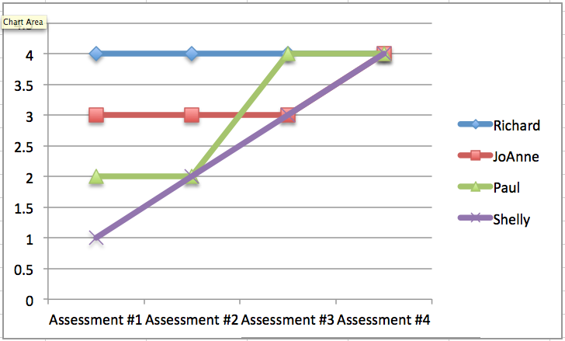

GRADING PRACTICES
Fix #14 – Tendency vs Average
The most recent
score for all
is a 4!
If at first you don’t succeed,
skydiving may not be for you!
Tendency
Trends
Average
Mastery

Slide 20


Your Conversion Scale has been set… now what does a 4 or a C really mean?
C
With teachers at your Grade Level
With teachers at your School
With teachers in the District
What does it mean for next placement?
How are Special Needs students graded?
What do students need to know and
be able to demonstrate?
Everyone on the Same Page

Slide 21
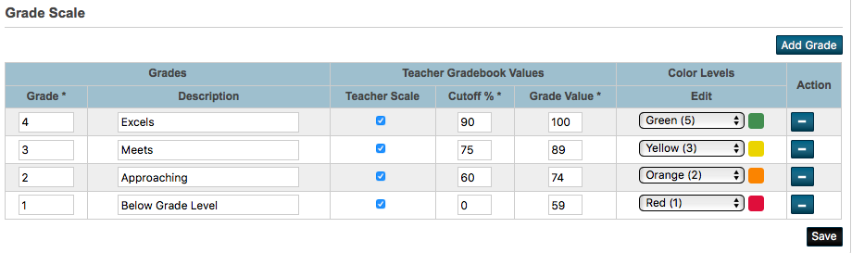
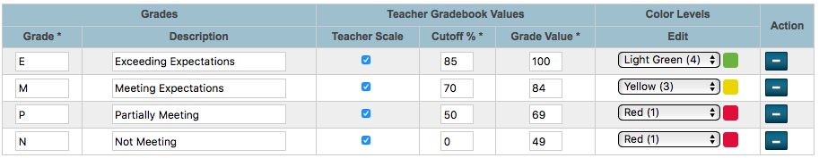
Grade Scales
Courses use Grade Scales – Assignments, Standards use Grade Scales
4 = 90-100, 3 = 75-89, 2 = 60=74, 1 = 0-59
E = 85-100, M = 70-84, P = 50=69, N = 0-49
Technical Note - 8 Character Limit

Slide 22

Homebound Assessment
C
Avoid Confusion- Adjust Rubrics and assessments
Sending Home Letter Grades and Percentages will confuse Parents and Students
How does an
A-, B+, 93, 82, B-
EQUAL a 3?

Slide 23
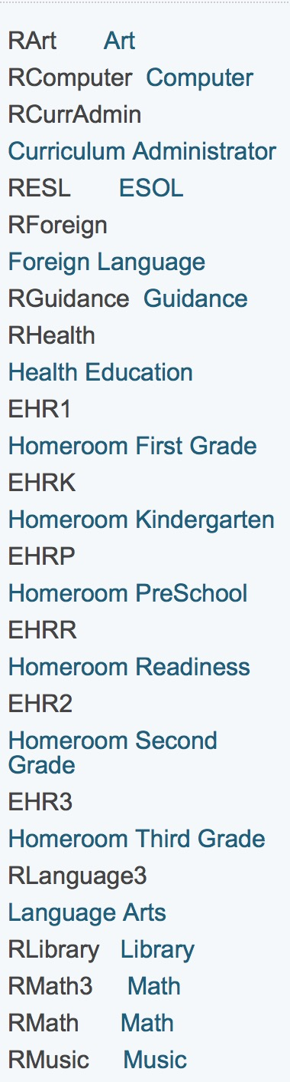
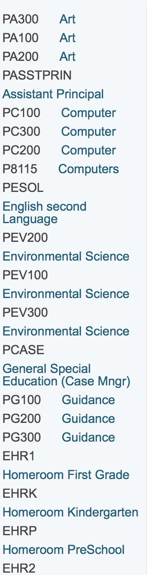
Standards associated to Courses
School 1
School 2
ASSUMING
300-200-100 REPRESENTS
GRADES 3,2,1
WHAT CAN SCHOOL 2 DO THE SCHOOL 1 CAN’T??
YOU CAN’T HAVE GRADE LEVEL SPECIFIC STANDARDS
TIED TO THE SAME COURSE #
ARE SPECIAL EDUCATION
TEACHERS GRADING THE SAME STANDARDS????
MOST PULL OUT SPED COURSES
aren’t grade level specific

Slide 24
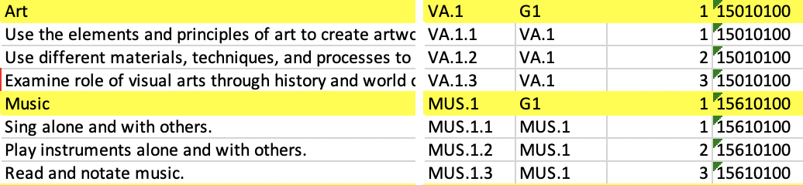
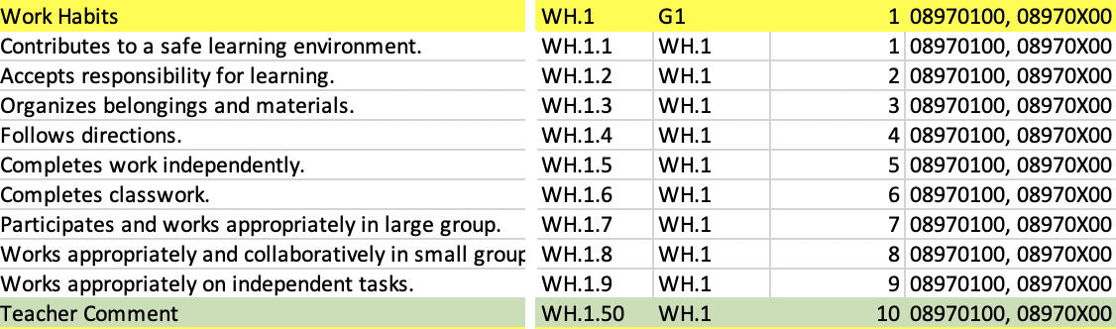
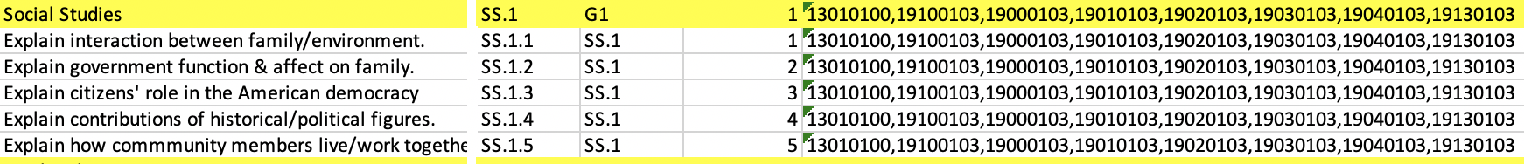
Standards associated to PrimaryCourses
Name
Identifier
1
ParentStandardIdentifier
2
PrimaryCourses
6

Slide 25
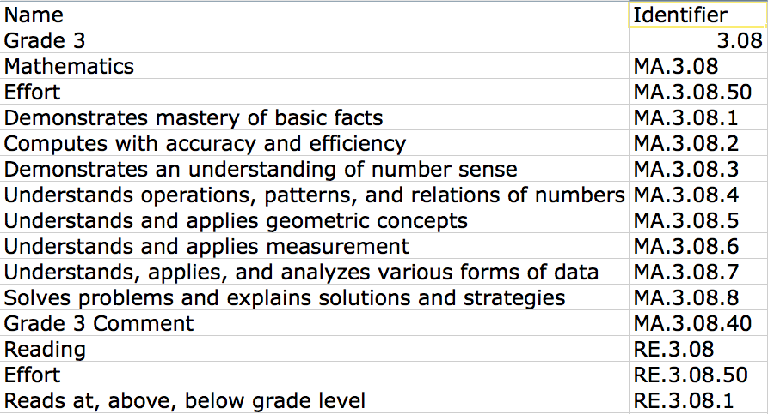
STANDARDS NAMING SCHEMA
CT
65*-75 Character Limit
BobC Recommendation – ParkBench Visual PST V3!!

Slide 26
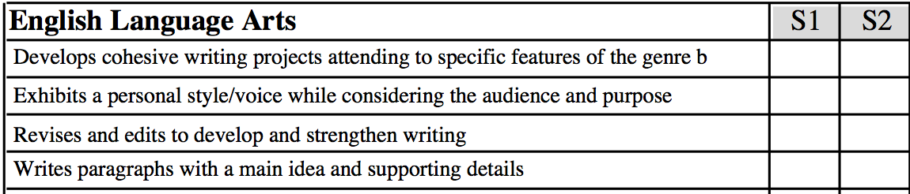
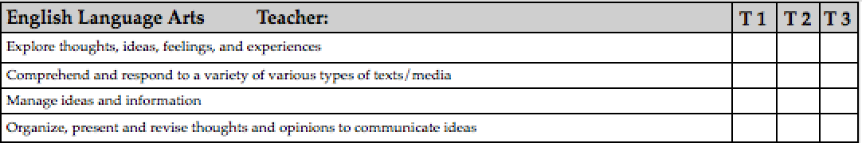
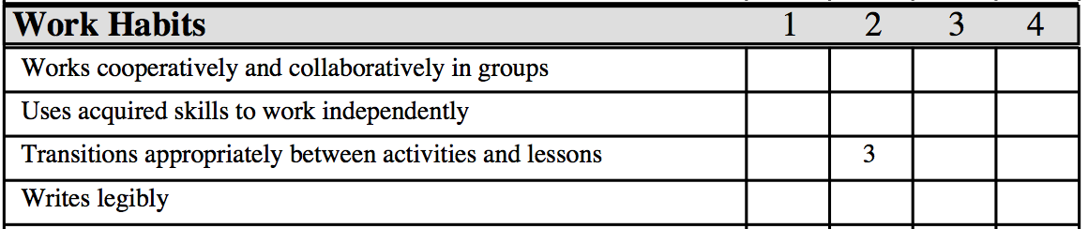
# of Reporting Periods dictates the # of characters
(on printed object report cards – PARKBENCH VISUAL PST V3 addresses this!)
75
70
65

Slide 27
Consider a user friendly schema for standard identifiers
Removing a,b,c will save time- import template and report cards
FIRST AND BIGGEST MISTAKE!!
Do you need to use these “wacky” identifiers?
Have teachers LEARNED these identifiers?

Slide 28
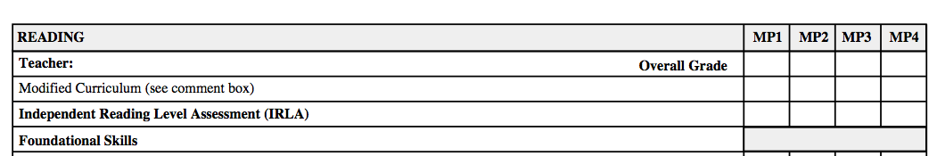
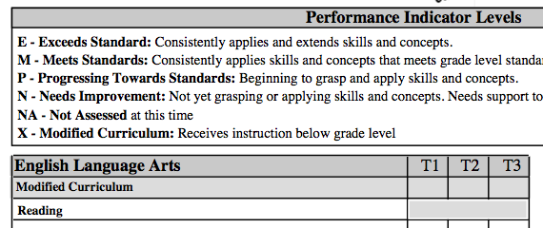
DELIMMA
Special Needs Students/Teachers
HOW
In SC there are multiple levels of Special Education services possibly requiring up to 8 course #’s
10010100,19100100,19000100,19010100,19020100,19030100,19040100,19130100

Slide 29





Additional Considerations
Beware of Pilots!
Where do you start?
K-4
1-5
6-8
Receiving Schools?
5-8
K-8
9-12
Prerequisites?
K-4
K-4
K-4
K-4
5-8
Retention and Honor Roll Policies
STRONG CURRICULUM LEADERSHIP IS A MUST!
5-8
9-12

Slide 30
What does FINAL version mean?
WHAT
DO YOU MEAN IF
I CHANGE STANDARDS
DURING THE YEAR I CAN’T
RE-USE
THE UNIQUE IDENTIFIERS!!
DO I HAVE TO CHANGE
ALL MY REPORT
CARDS?
Make sure FINAL really means FINAL
No More Changes for 1 year!!
When do you import the standards or new standards?
Send and Save email to curriculum –
“Are you planning any changes to the standards?”
NO

Slide 31
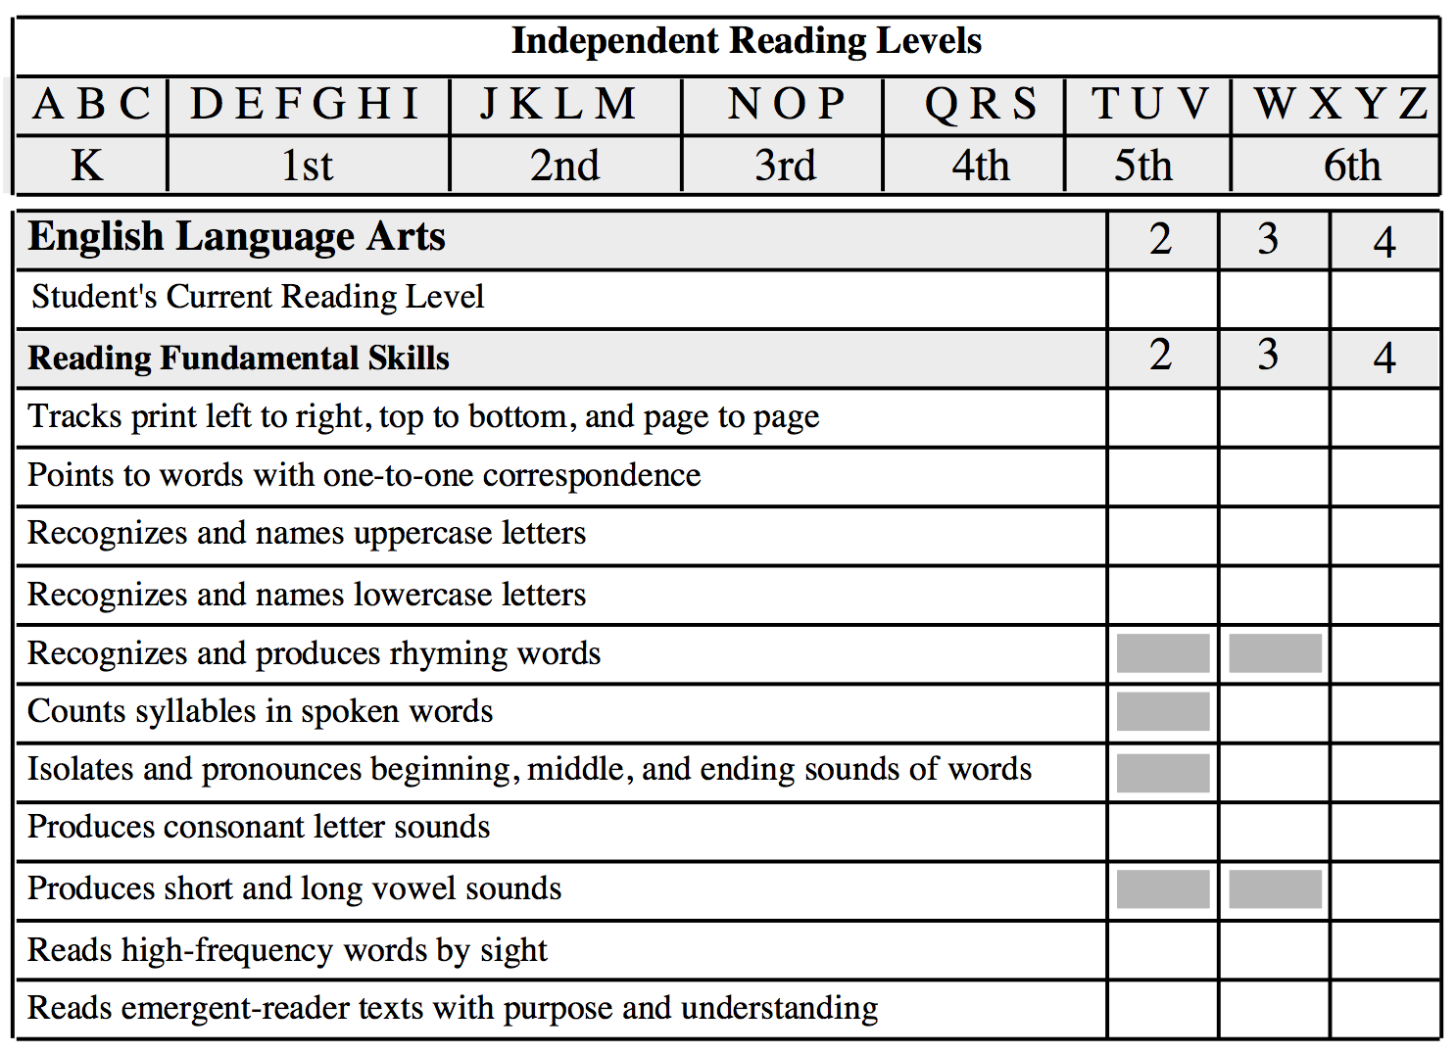
O
U
O
O
O
Wisconsin Parent...
“Now that I know what standard my daughter is struggling with, I hope I can understand what the standard means?”
S
O
O

Slide 32
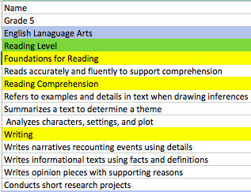
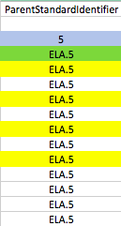



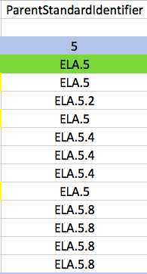
Standard Import Template
When do you import the standards?
Samples can be found on my website
http://www.derotechnical.com/STANDARDS/CharacterCount.html

Slide 33
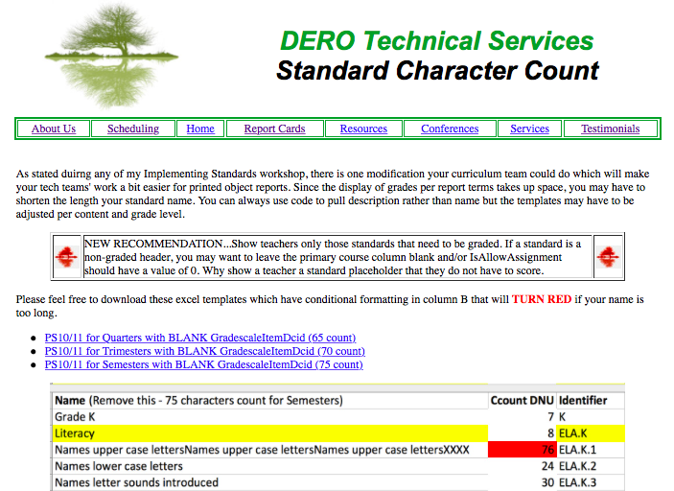
Character Count for Standards
http://www.derotechnical.com/STANDARDS/CharacterCount.html

Slide 34
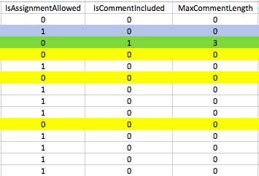
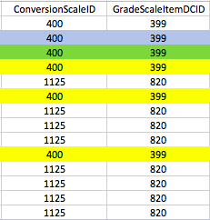
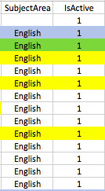
Standard Import Template
If your district wanted to roll-up child standards scores to
auto-calculate the parent standards scores many columns
would have to change. 50% of teachers report that they
over-write the calculated grades.

Slide 35
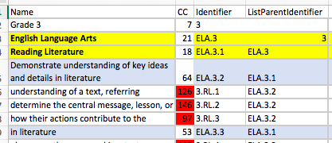
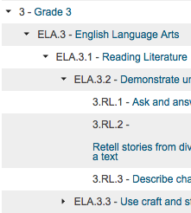
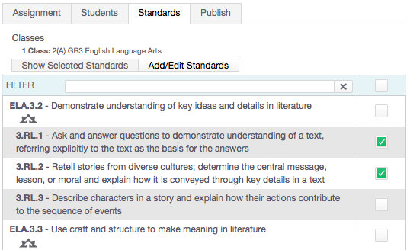
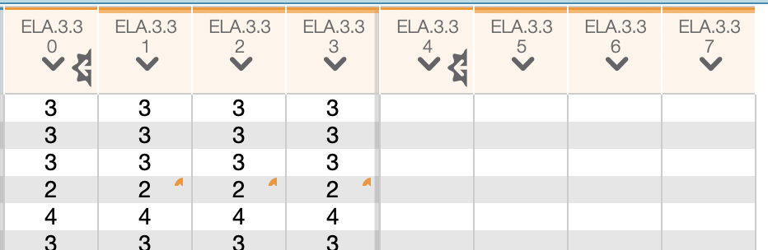
ListParentIdentifier - Rollup
ListParentIdentifier – places “child” standards under their parents

Slide 36
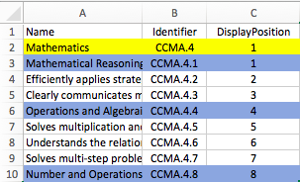
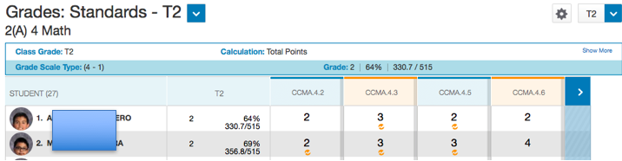
Display Position
CCMA.4
CCMA.4.1
CCMA.4.4
DO NOT SHOW IN THE GRADEBOOK!
WHY?

Slide 37
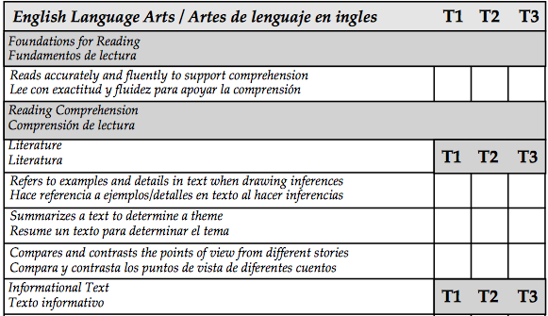
What to show in the PTP?
CELA.4.2
CELA.4.3
CELA.4.4
CELA.4.5
CELA.4.6
CELA.4.7
CELA.4.8
CELA.4.9

Slide 38
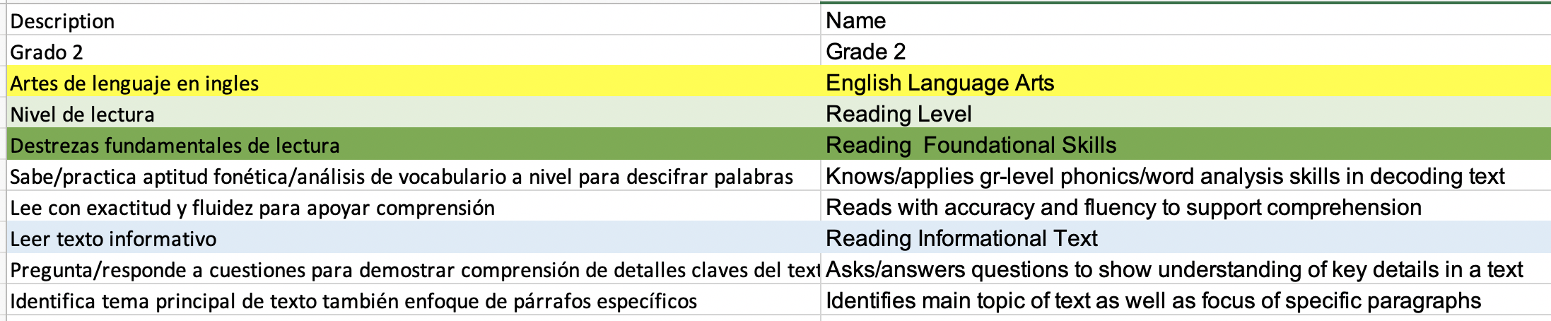
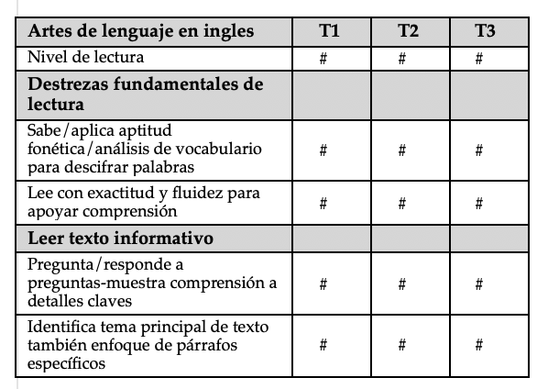
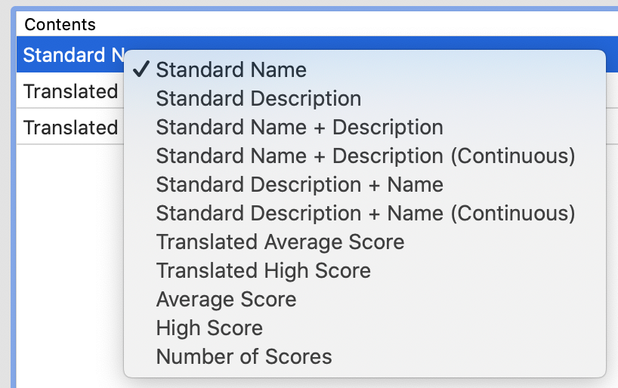
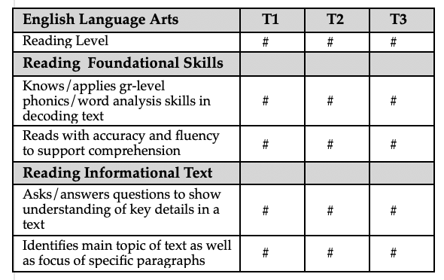
Need Spanish or “one” other language too?
If aren’t using the description field for anything – longer full standard name/identifier – you could use that field for Spanish description
Standard Name = English

Slide 39
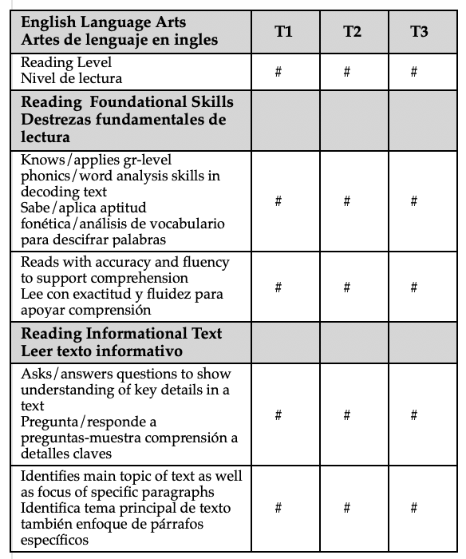
Need Spanish or “one” other language too?
Standard Name + Standard Description = BOTH
Standard Description = Spanish
Park Bench Visual PST – VERSION 3

Slide 40
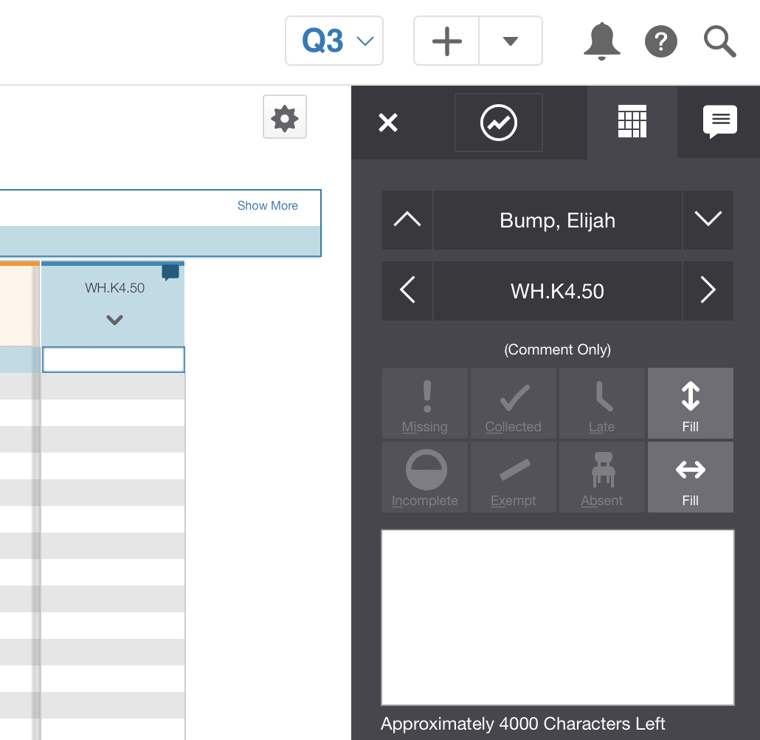
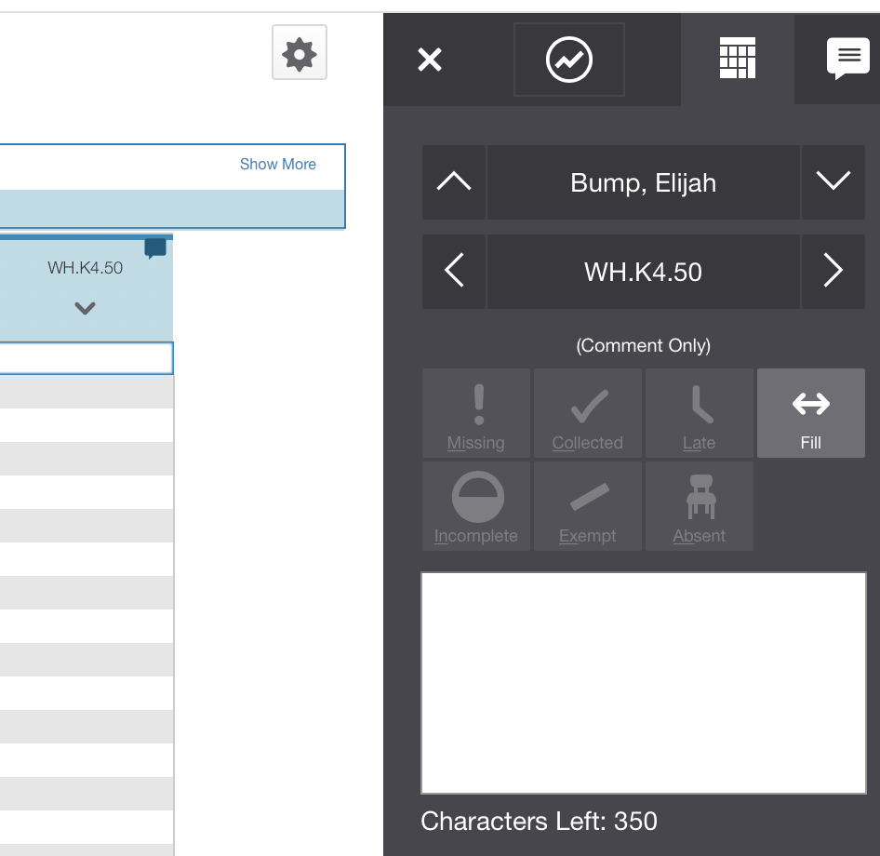
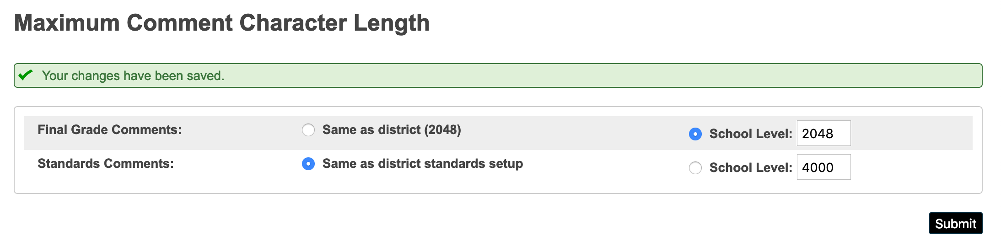



Max Character Count ONLY works if…

Slide 41
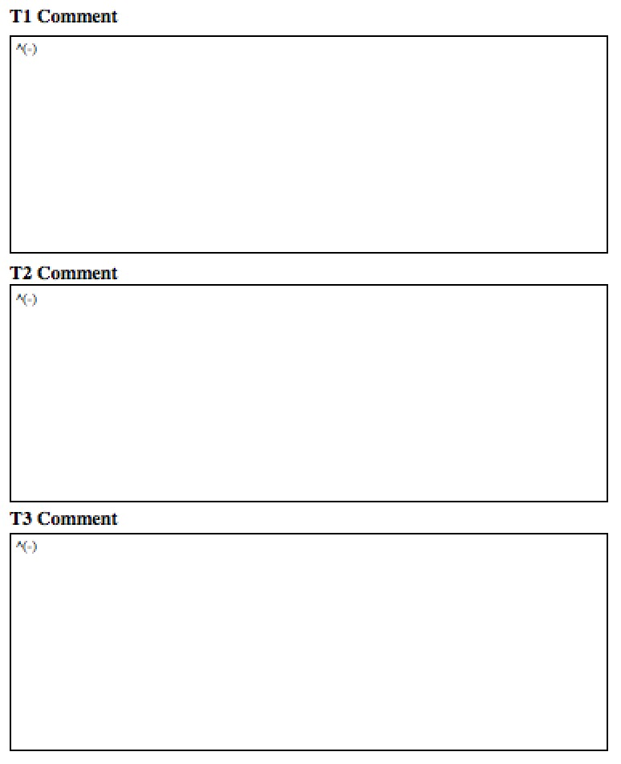


Additional Thoughts on Comments
Create a standard called
Teacher Comment associate to HR or
Subject Comment to Subject
How do you set the correct length?
When you create an entry box on your report card use the same sized box for all grades all subjects. Content specific comments are NORMALLY shorter than a summative narrative

Slide 42


Importing via
Data Import Manager
Original spreadsheet
Can’t be re-imported as you will ID and Longitudinal ID
Use all the fields – JUST EASIER
ID must be used when re-importing**

Slide 43


RE-IMPORTING ISSUES
The process of importing standards CREATES TWO FIELDS IN YELLOW
IF CHANGES – export standards including ID and LongitudinalID
Sort – change and re-import

Slide 44

Standards have to be managed
YEAR TO YEAR/EOY or...
MUST SET UP AT THE DISTRICT LEVEL 2018 - 2019
YOU MUST THEN BE IN CURRENT YEAR
CREATE STANDARDS LIST for YearID 28 OR 29???
Create Next Year’s List of Standards Prior to End-of-Year
√ 24,012 standards were created for 2017-2018
COPIES ALL CURRENT YEAR STANDARDS – ACTIVE AND INACTIVE
EOY PROCESS WILL NOT COPY OVER STANDARDS - IN ADVANCE!
IF YOU CHANGE STANDARDS AFTER CREATING….????

Slide 45


Have you thought about Report Cards?
CT
Parent Portal – access to grades – list form
NOT DYNAMIC – all must be custom made
Object Reports vs. Online
Summative
Multi-page requires duplex printer
http://www.derotechnical.com/REPORTCARDS/REPORTCARDS.html

Slide 46

STANDARDS by TERM
ParkBench Visual PST V3.1 gives you the ability shade in gray!

Slide 47


Gray Boxes – Disabled Scores
Version 3.1 check a box rather than draw a box!!

Slide 48

25 MINS
All ABOUT
STANDARDS!

Slide 49

Mark Anderson must understand us!!
I can’t this weekend, I’m doing a PowerSchool Administrator Triathlon
Creating new standards in Excel from WORD
Learning to make new grade scales
Building 8 new report cards

Slide 50

CURRICULUM LEADERSHIP
TECHNICAL TEAM or YOU
Develop Process and Timeline
Establish a team (WITH TECH FOLKS)
Discuss PILOTS for District
Gather Resources
Create Grade Level Teams/Leaders
Plan STAKEHOLDER communications
Review Curriculum and Assessments
Establish/Create the Rubrics/Scales
Discuss Special Ed, GIFTED, ELL Students
Word smith for understanding & shorten
Draft list of STANDARDS in EXCEL not WORD
ELA-MA-Work Habits-SCI-SOC- Specials
Cherry Pick BETTER standards
Review samples of SB report cards
Decided Printable/Online report cards
Word smith for understanding & shorten
Provide FINAL excel to Tech Team
Plan adequate PD for Gradebook Training
Set Faculty/Grade Level Sharing Expectations
Attend Standards Meetings
Review Course Numbers (at each school)
Create Grade Scales once provided
Understand columns standard import files Build Standard Import Template
Send it to BobC – Reviews for FREE
WHEN FINAL – Import (opt- no primary)
Research Object Reports or Online Options
Create or contract for report card
Create a single grade to PERFECTION
Bring Constraints to Curriculum Team
SIGN-OFF on designed report card
Learn Gradebook even if you aren’t training
Create all report cards/import
Find your early graders!!
ADEQUATE TIME
STANDARD SELECTION PROCESS
CREATION/IMPORT of STANDARD TEMPLATE
REFLECTION
ASSESSMENT/GRADING CHANGES
PROFESSIONAL DEVELOPMENT
CREATION OF THE SBRC
Skipping these steps will result in continuous revisions and most
often FAILURE!

Slide 51
ANY AND ALL DERO RESOURCES ARE AVAILABLE
TO DOWNLOAD, TWEAK and USE FOR YOUR DISTRICT!
Q & A
Bob Cornacchioli
get2bobc@gmail.com
www.derotechnical.com

